Slide 1


Programming Language Concepts Tutorials
Become a Programming Languages Designer
Supervised by Dr. Kenny Zhu
TAs: Essam Abdelghany

Slide 2
Pop Quiz
Reminder in tutorials we recap on lecture, discuss assignments, discuss project or programming and solve practice problems.

Slide 3

Pop Quiz
1) The minimum number of expression types to define a language, computationally as powerful as C++, is:
a) Three
b) Four
c) Number of orthogonal constructs in C
d) Seven

Slide 4
Pop Quiz
2) In lambda calculus, values are……….
a) Integers, functions and other constants
b) Variables
c) Referenced with pointers
d) Functions only

Slide 5
Pop Quiz
3) Reducing outermost-leftmost redex first (outside of lambda abstraction)……….
a) Corresponds to call-by-value evaluation
b) Corresponds to call-by-name evaluation
c) Corresponds to full-beta reduction
d) None of the above

Slide 6
Pop Quiz
4) Corresponds to lazy evaluation
a) Call by value
b) Call by name
c) Full beta reduction
d) None of the above

Slide 7
Pop Quiz
4) Suppose (𝜆𝑦. 𝑒1)[𝑒/𝑥] and 𝑦 ∈ 𝐹𝑉(𝑒)……….
a) Pick 𝑞 ∉ 𝐹𝑉(𝑒) then 𝜆𝑞. 𝑒1[𝑞/𝑦][𝑒/𝑥]
b) Pick 𝑞 ∉ 𝐹𝑉(𝑒1) then 𝜆𝑞. 𝑒1[𝑞/𝑦][𝑒/𝑥]
c) Just plug 𝜆𝑦. 𝑒1[[𝑒 ← 𝑥]]
d) Just plug 𝜆𝑦. 𝑒1[[𝑒 ← 𝑦]]

Slide 8
Assignment Solution

Slide 9
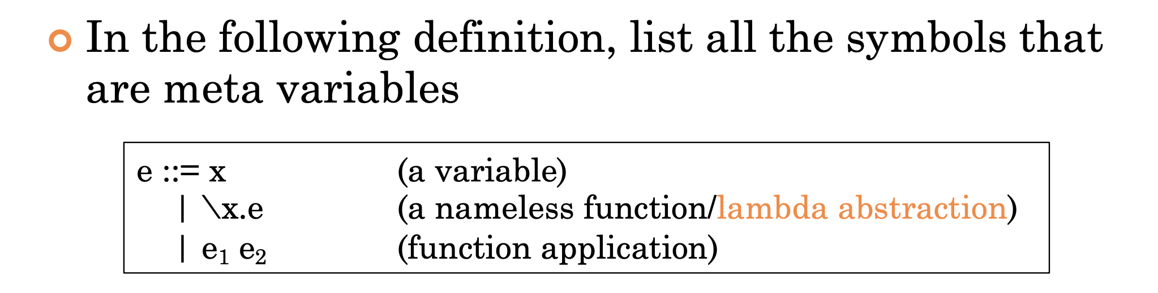
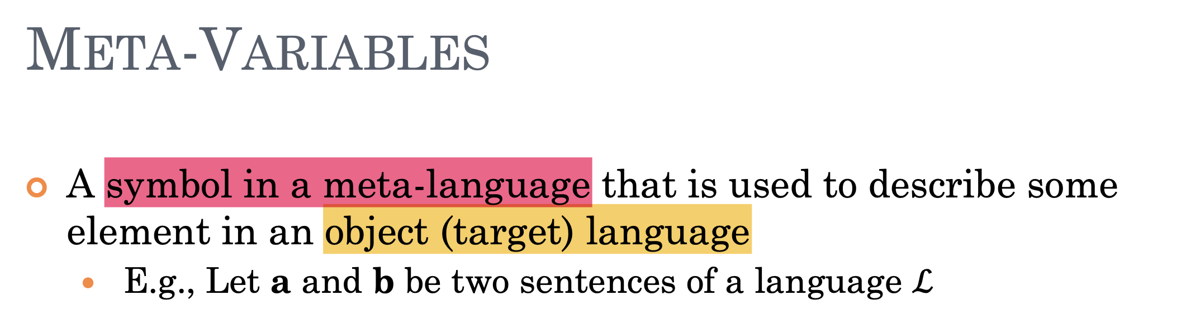

Assignment Solution
$e, x, e_{1}, e_{2}$are all metavariables
Statement written in the Backus-Naur form

Slide 10
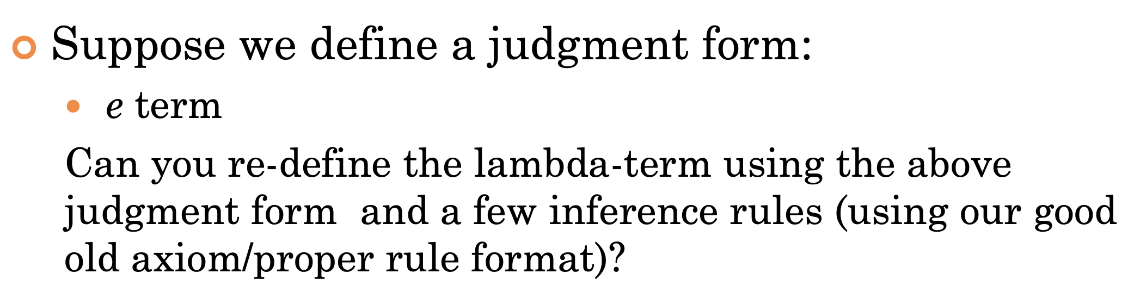

Assignment Solution
Should be equivalent to $e := x \left| λ. x e \right|e_{1} e_{2}$
$$\frac{ }{x term}[variable],\frac{e term}{λx.e term}[abstraction],\frac{e_{1} term e_{2} term}{e_{1} e_{2} term}[functionCall]$$

Slide 11
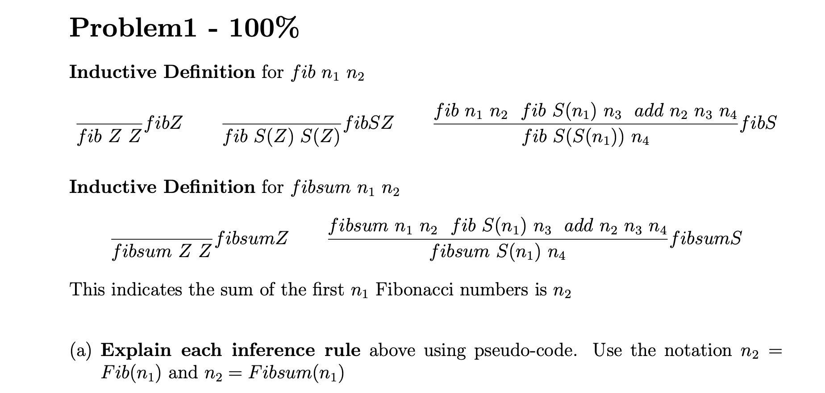
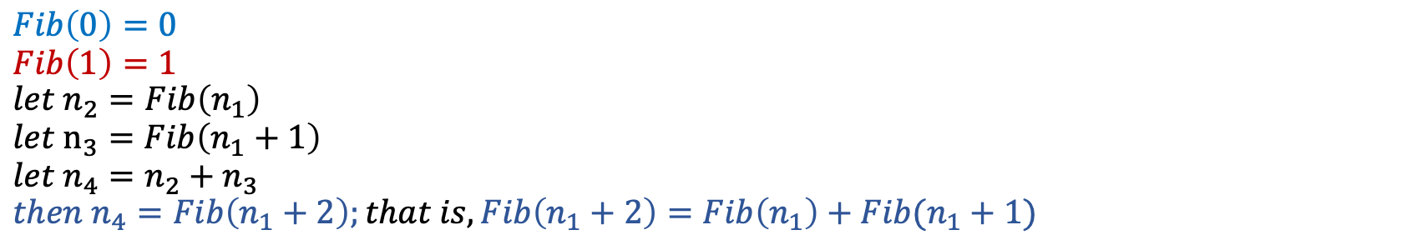
Assignment Solution
$$Fib\left(0\right)=0 \\ Fib\left(1\right)=1 \\ {let n}_{2}=Fib\left(n_{1}\right) \\ {let n}_{3}=Fib\left(n_{1}+1\right) \\ let n_{4}=n_{2}+n_{3} \\ then n_{4}=Fib\left(n_{1}+2\right);that is,Fib\left(n_{1}+2\right)=Fib\left(n_{1}\right)+Fib(n_{1}+1)$$

Slide 12
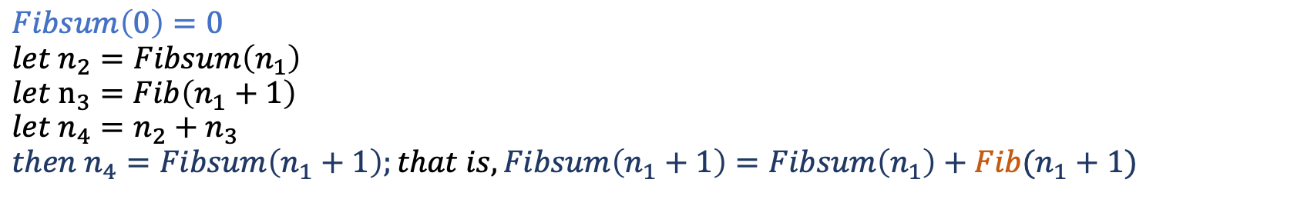
Assignment Solution
$$Fibsum\left(0\right)=0 \\ {let n}_{2}=Fibsum\left(n_{1}\right) \\ {let n}_{3}=Fib\left(n_{1}+1\right) \\ let n_{4}=n_{2}+n_{3} \\ then n_{4}=Fibsum\left(n_{1}+1\right);that is,Fibsum\left(n_{1}+1\right)=Fibsum\left(n_{1}\right)+Fib(n_{1}+1)$$

Slide 13
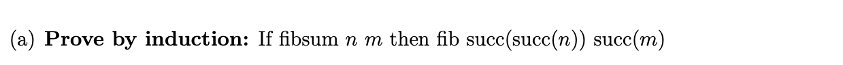
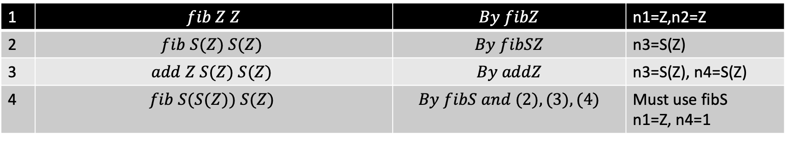
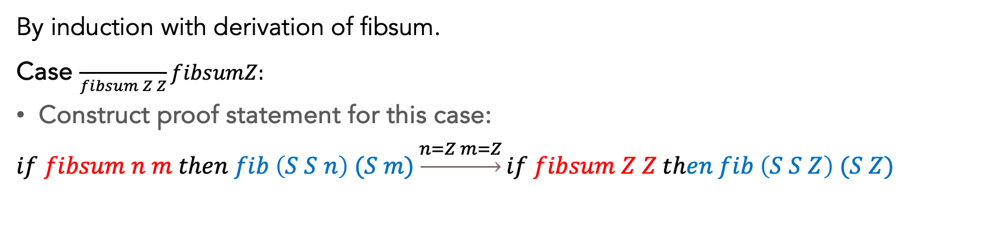
Assignment Solution
By induction with derivation of fibsum.
Case $\frac{ }{fibsum Z Z}fibsumZ:$
Construct proof statement for this case:
$$if fibsum n m then fib \left(S S n\right) (S m)\underset{→}{n=Z m=Z}if fibsum Z Z then fib \left(S S Z\right) (S Z)$$
1 | $$fib Z Z$$ | $$By fibZ$$ | n1=Z,n2=Z
2 | $$fib S(Z) S(Z)$$ | $$By fibSZ$$ | n3=S(Z)
3 | $$add Z S(Z) S(Z)$$ | $$By addZ$$ | n3=S(Z), n4=S(Z)
4 | $$fib S(S(Z)) S(Z)$$ | $$By fibS and (2),(3),(4)$$ | Must use fibS n1=Z, n4=1

Slide 14
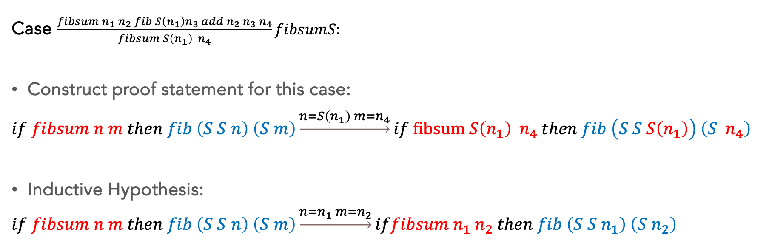
Assignment Solution
Case $\frac{fibsum n_{1} n_{2} fib S\left(n_{1}\right)n_{3} add n_{2} n_{3} n_{4}}{fibsum S\left(n_{1}\right){ n}_{4}}fibsumS:$
Construct proof statement for this case:
$$if fibsum n m then fib \left(S S n\right) \left(S m\right)\underset{→}{n=S\left(n_{1}\right) m=n_{4}}if fibsum S\left(n_{1}\right){ n}_{4} then fib \left(S S S\left(n_{1}\right)\right) \left(S{ n}_{4}\right)$$
Inductive Hypothesis:
$$if fibsum n m then fib \left(S S n\right) \left(S m\right)\underset{→}{n=n_{1} m=n_{2}}iffibsum n_{1} n_{2} then fib \left(S S n_{1}\right) \left(S n_{2}\right)$$

Slide 15
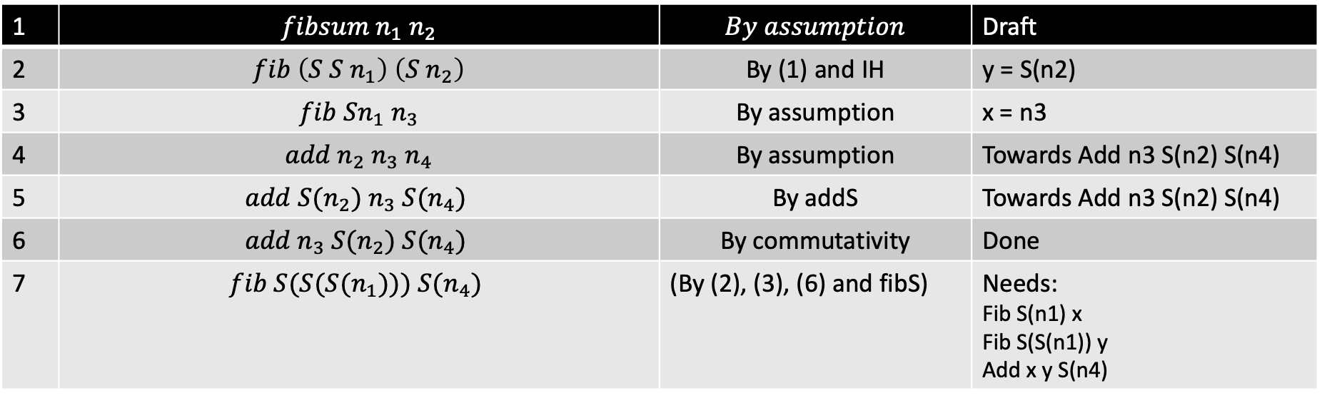

Assignment Solution
Construct proof statement for this case:
$$if fibsum S\left(n_{1}\right){ n}_{4} then fib \left(S S S\left(n_{1}\right)\right) \left(S{ n}_{4}\right)$$
Inductive Hypothesis:
$$iffibsum n_{1} n_{2} then fib \left(S S n_{1}\right) \left(S n_{2}\right)$$
1 | $$fibsum n_{1} n_{2}$$ | $$By assumption$$ | Draft
2 | $fib \left(S S n_{1}\right)$ $\left(S n_{2}\right)$ | By (1) and IH | y = S(n2)
3 | $$fib Sn_{1} n_{3}$$ | By assumption | x = n3
4 | $$add n_{2} n_{3} n_{4}$$ | By assumption | Towards Add n3 S(n2) S(n4)
5 | $$add {S(n}_{2}) n_{3} S(n_{4})$$ | By addS | Towards Add n3 S(n2) S(n4)
6 | $$add n_{3} S(n_{2}) S(n_{4})$$ | By commutativity | Done
7 | $$fib S(S(S(n_{1}))) S(n_{4})$$ | (By (2), (3), (6) and fibS) | Needs: Fib S(n1) x Fib S(S(n1)) y Add x y S(n4)

Slide 16
Thank You

